Slide 1

OpenIPSL Tutorial A Modelica Library for Power Systems Simulation
Assoc. Prof. Luigi Vanfretti
luigiv@kth.se,
https://www.kth.se/profile/luigiv/
Notes:
Airport to central station
Take line 3 or line 4 to Nyl… (Stattnet)

Slide 2

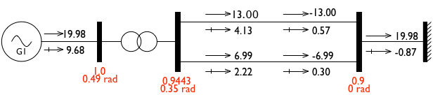
Workshop Agenda
Introduction to the Open-Instance Power System Library
Modelling and simulation possibilities by using OpenIPSL and Modelica
Comparison of the performance with a reference simulation software
3 use cases with a dynamic simulation and linearization

Slide 3
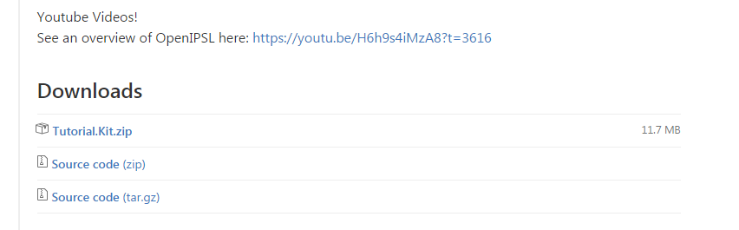
Download OpenIPSL!
Go to our Github repo:
https://github.com/SmarTS-Lab/OpenIPSL/releases/tag/Tuto_PTI_Brazil_17
Note: Download the dedicated package for the tutorial (Tutorial.Kit.zip) so everybody has the same files. The dedicated package is also available on a usb stick that we can circulate to the participants.
Click Here!

Slide 4
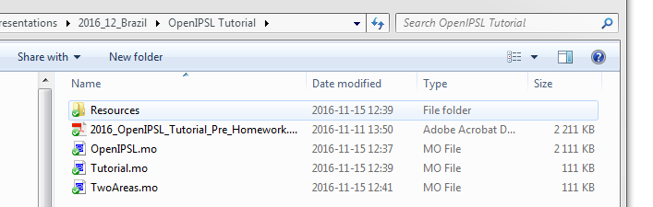
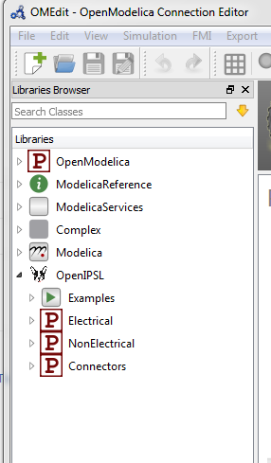
Load the OpenIPSL to OMEdit
External libraries, such as OpenIPSL, must be loaded in OMEdit to be used:
Unzip the package downloaded at the previous step
Open OpenModelica Connection Editor (OMEdit)
Browse Windows Explorer to the location of the unzipped folder
Drag & drop the OpenIPSL.mo file to the Library Browser in OMEdit.

Slide 5
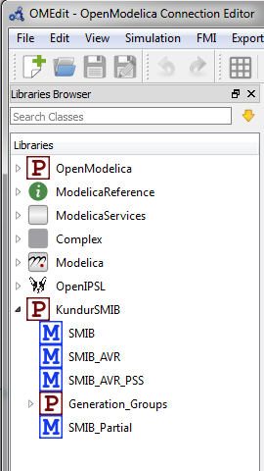
Load an Application Example to OMEdit
Once the OpenIPSL is loaded (see previous slide) in OMEdit, you can load the Tutorial package:
Browse Windows Explorer to the location of the unzipped folder
Drag & drop the Tutorial.mo file to the Library Browser in OMEdit.

Slide 6
Library introduction
OpenIPSL is divided in four main categories:
Examples
Electrical
NonElectrical
Connectors
OpenIPSL
Electrical
NonElectrical
Connectors
Examples
Machines
Branches
Loads
Banks
Sensors
Events
Solar
Buses
Controls
Wind
Math
Logical
Continuous
Nonlinear
Functions

Slide 7
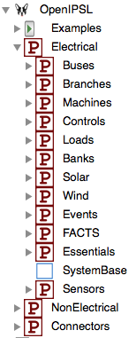
Library introduction
Electrical
The Electrical package contains most of the components that comprise an actual power network
E.g., electrical machines, transmission lines, loads, excitation systems, turbine governors, etc.
These are used to build the power system network models

Slide 8
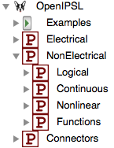
Library introduction
NonElectrical
The NonElectrical package is comprised by functions, blocks or models, which are used to build the aforementioned power system component models : Transfer functions, logical operators, etc.
They perform specific operations which were not available in the Modelica Standard Library (MSL)
Connectors
The Connectors package contains a set of specifically developed Modelica connectors to harmonize the models in this library ( e.g. PwPin a connector, which contains voltage and current quantities in phasor representation)

Slide 9
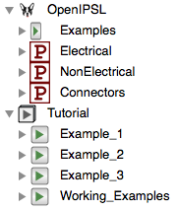
Library introduction
Examples
In this workshop, the Tutorial package will be used to showcase the possibilities of the library
In the packages Example_1, Example_2 and Example_3 prepared use cases can be found where steps to build the models are described
Package Working_Examples and corresponding sub-packages will be used by attendees of the workshop to create use cases on their own

Slide 10
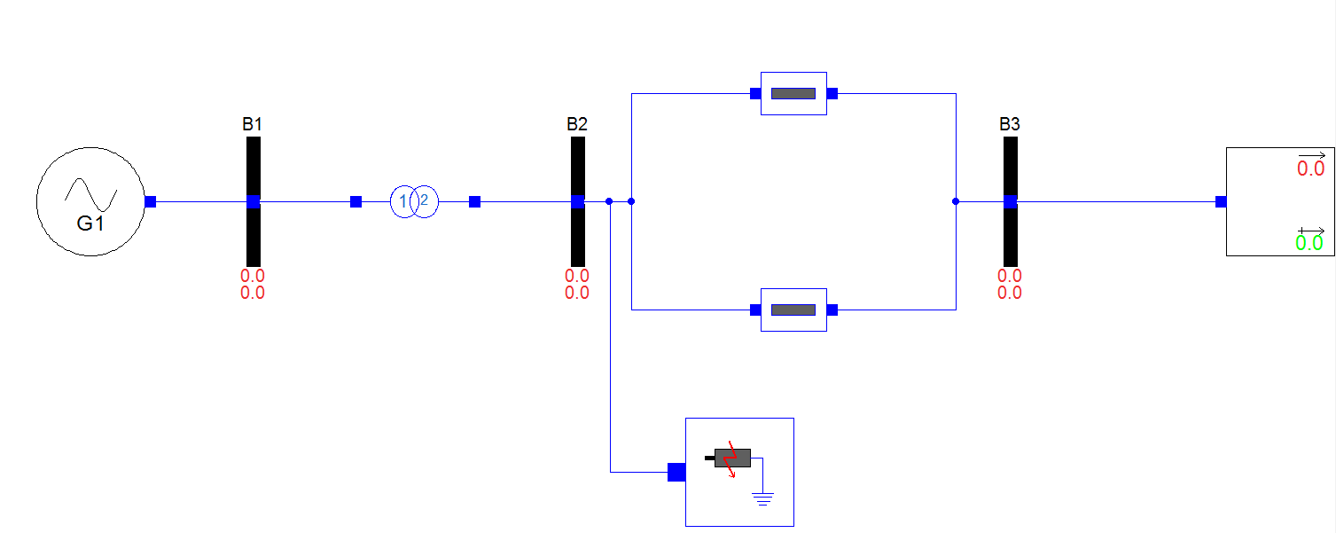
Example 1*
Single Machine Infinite Bus (SMIB) system
Analysis of the transient stability of the system including the effects of rotor circuit dynamics and excitation control
Four machines represented by one connected via transformer and parallel lines to the infinite bus
* P. Kundur, “Power System Stability and Control”, Example 13.2

Slide 11
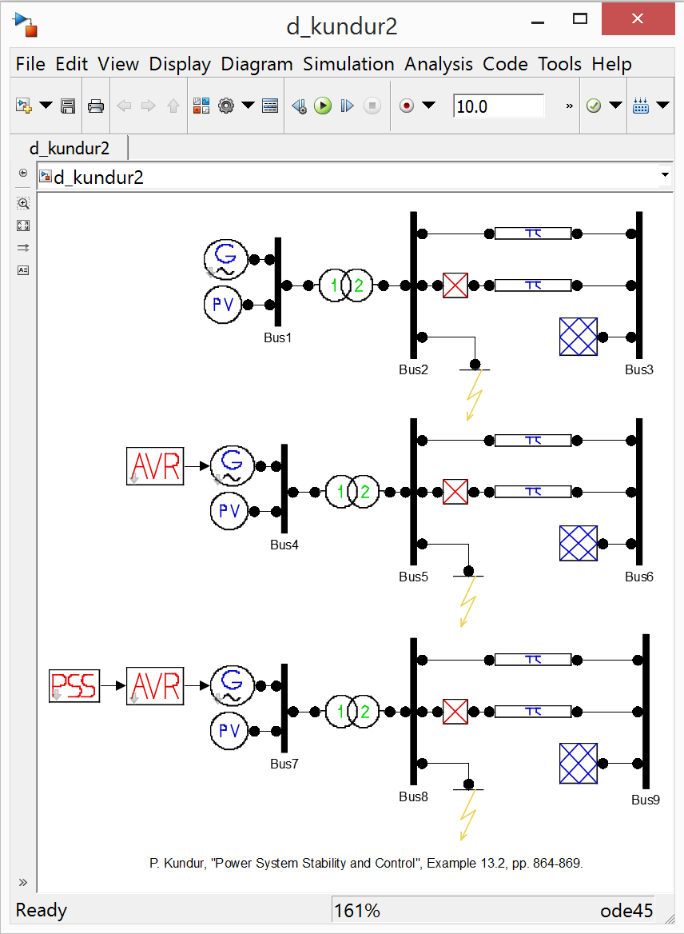
Example 1
Power flow
Power flow results were obtained by PSAT
Prepared Example 1 already exists in PSAT and can be used for power flow calculations and dynamic simulations

Slide 12
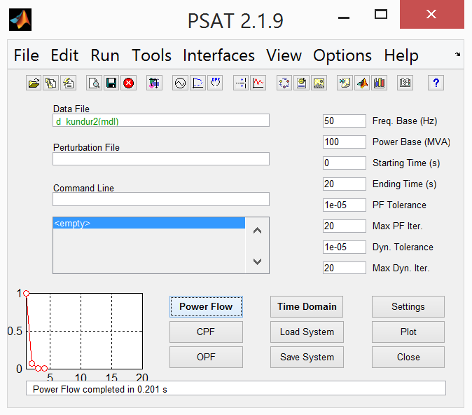
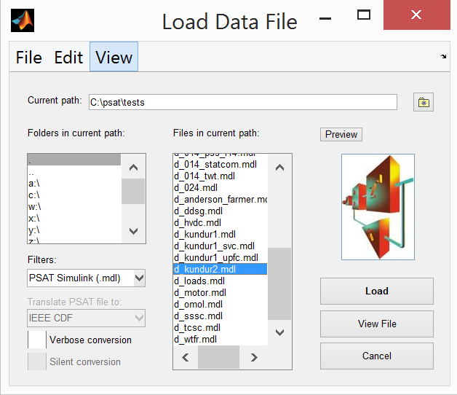
Example 1
Power flow
Example 1 is loaded and the power flow calculations are executed

Slide 13
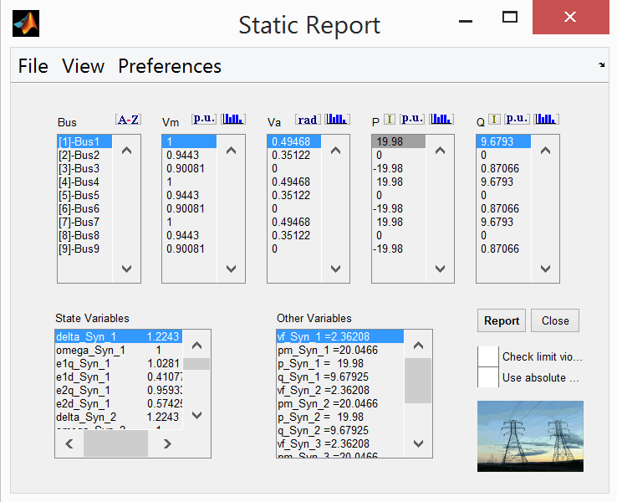
Example 1
Power flow
Static Report can be access where all of the power flow results are listed along with the initial values of various state variables of the models
In this tutorial, there is no need to run the power flow in PSAT since the data will be provided, but feel free to explore PSAT later

Slide 14
Example 1
Power flow
The summary of all of the relevant data from the power flow is given on the figure below

Slide 15
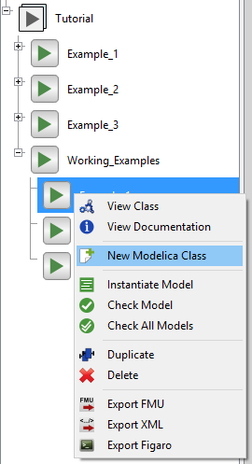
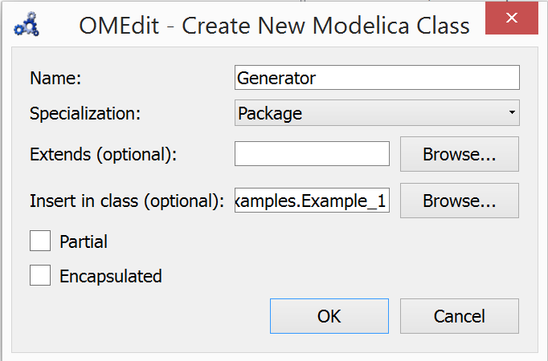
Example 1
Generator model – Step 1
First, the package where the generator model will be located has to be created
This is done by right clicking on the Example_1 in the Working_Examples package
The package should be named Generator

Slide 16
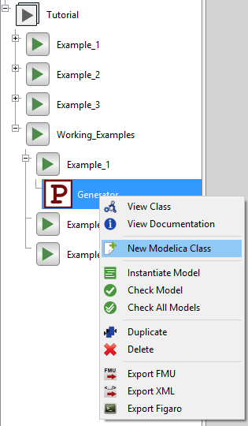
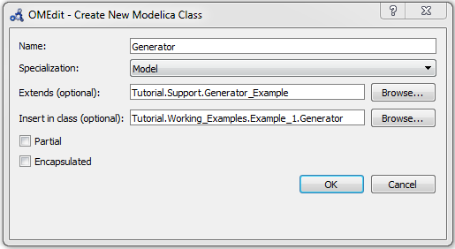
Example 1
Generator model – Step 1
Within the Generator package, model of the generator shall be created
Extends from Tutorial.Support.Generator_Example

Slide 17
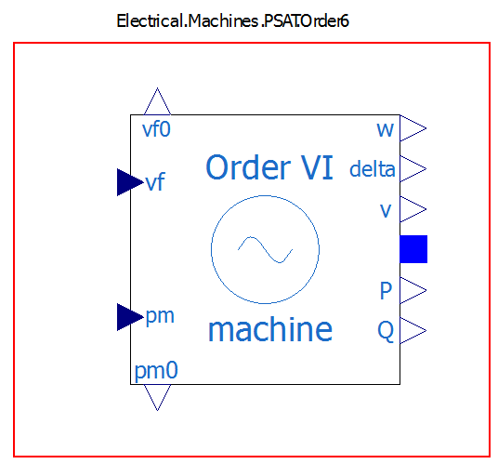
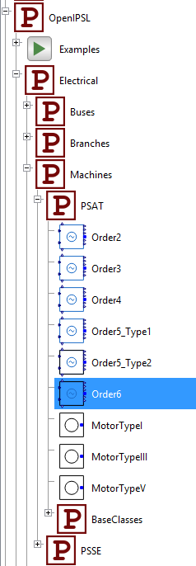
Example 1
Generator model – Step 1
6th order model of the generator from the PSAT is used
The model is added by dragging the generator from the library and dropping it to the model

Slide 18
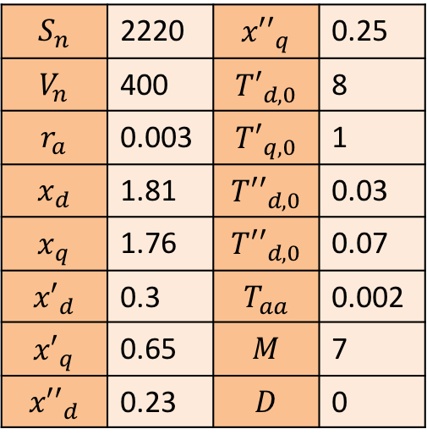
Example 1
Generator model – Step 1
Parameters of the generator are given in the table
$$S_{n}$$ | 2220 | $${x′′}_{q}$$ | 0.25
$$V_{n}$$ | 400 | $${T′}_{d,0}$$ | 8
$$r_{a}$$ | 0.003 | $${T′}_{q,0}$$ | 1
$$x_{d}$$ | 1.81 | $${T′′}_{d,0}$$ | 0.03
$$x_{q}$$ | 1.76 | $${T′′}_{d,0}$$ | 0.07
$${x′}_{d}$$ | 0.3 | $$T_{aa}$$ | 0.002
$${x′}_{q}$$ | 0.65 | $$M$$ | 7
$${x′′}_{d}$$ | 0.23 | $$D$$ | 0

Slide 19
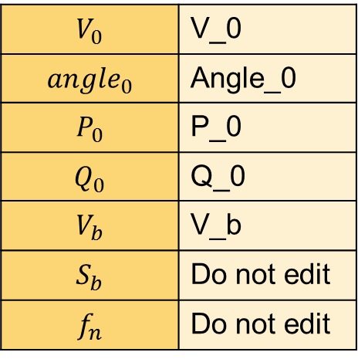
Example 1
Generator model – Step 1
Power flow results:
Note: Using the variables (V_0, Angle_0, etc.) allow to propagate the parameters to the “upper layer” of the generator componen
$$V_{0}$$ | V_0
$${angle}_{0}$$ | Angle_0
$$P_{0}$$ | P_0
$$Q_{0}$$ | Q_0
$$V_{b}$$ | V_b
$$S_{b}$$ | Do not edit
$$f_{n}$$ | Do not edit

Slide 20
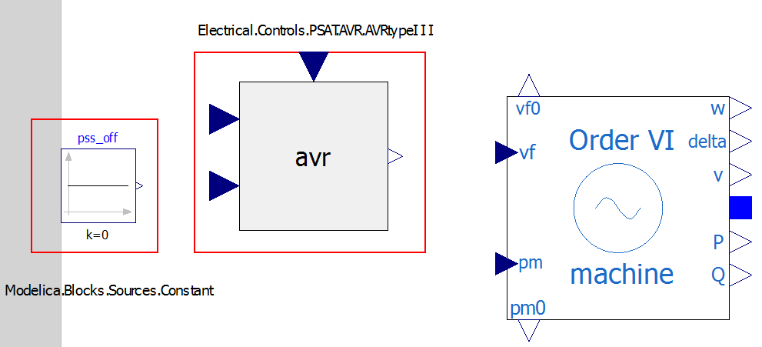
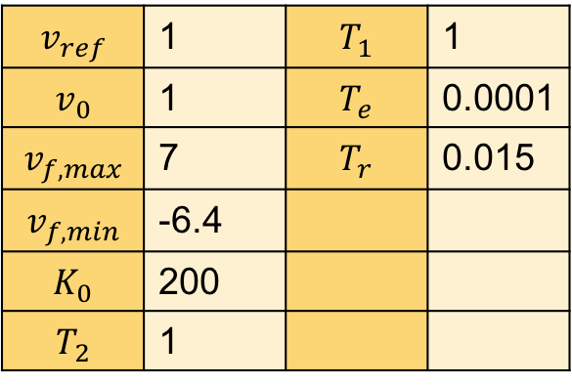
Example 1
Generator model – Step 2
PSAT model of the AVR Type III is used
Constant block pss_off will be used as a zero input to the PSS input signal of the AVR since the PSS is not used
Parameters:
$$v_{ref}$$ | 1 | $$T_{1}$$ | 1
$$v_{0}$$ | 1 | $$T_{e}$$ | 0.0001
$$v_{f,max}$$ | 7 | $$T_{r}$$ | 0.015
$$v_{f,min}$$ | -6.4
$$K_{0}$$ | 200
$$T_{2}$$ | 1

Slide 21
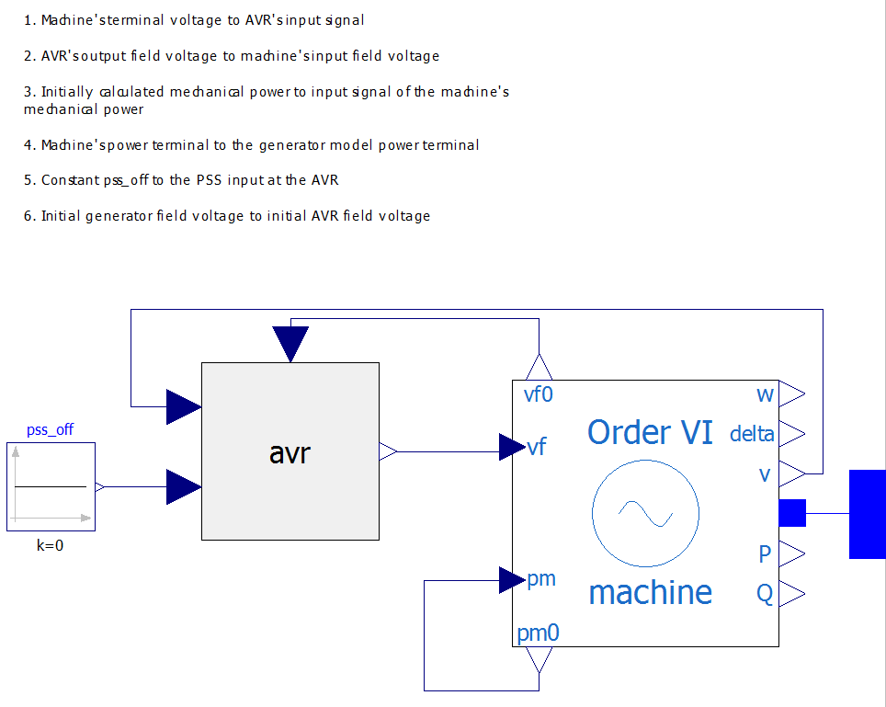

Example 1
Generator model – Step 3
To finish the generator model, different signals need to be connected
Optionally, icon of the generator model can be altered

Slide 22
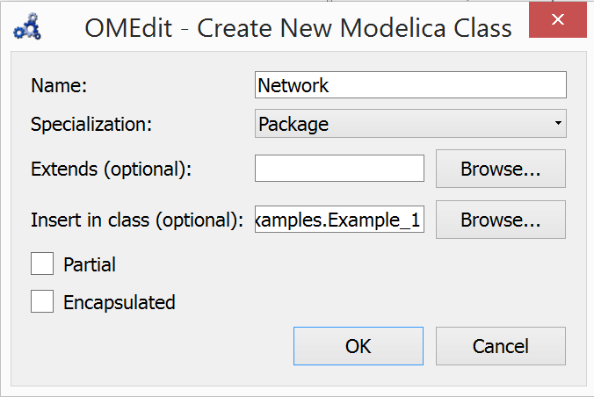
Example 1
Network model – Step 1
Network package will be created in the Example_1 package
This package is created by right clicking on the Example_1 in the Working_Examples package

Slide 23
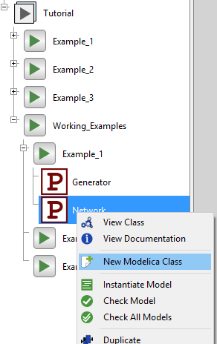
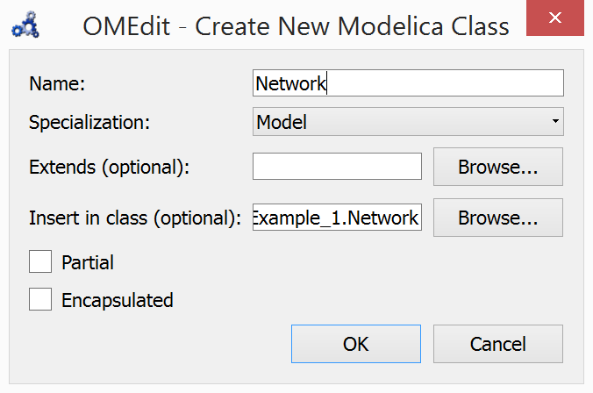
Example 1
Network model – Step 1
Network model will be created in the Network package
This package is created by right clicking on the Network package
The name of the network model will be Example_1

Slide 24
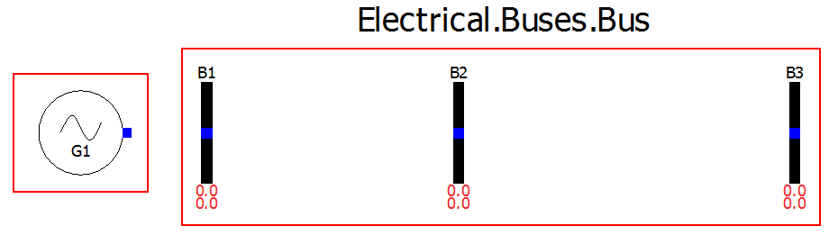
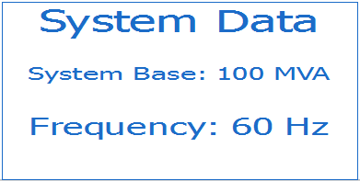
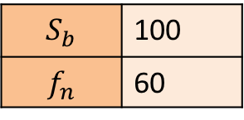
Example 1
Network model – Step 1
Created generator model and three bus models are added to the network model
Also, model OpenIPSL.Electrical.SystemBase shall be added to the network model which defines base parameters for all of the components in the network model
$$S_{b}$$ | 100
$$f_{n}$$ | 60

Slide 25
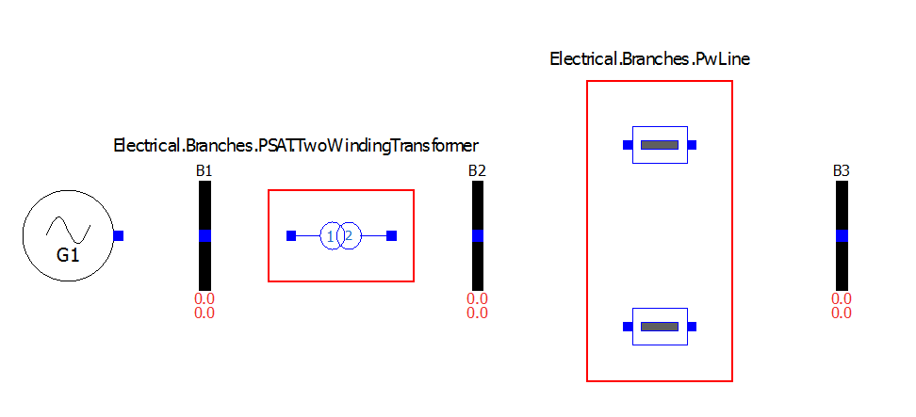
Example 1
Network model – Step 2
Transformer and line models are added

Slide 26
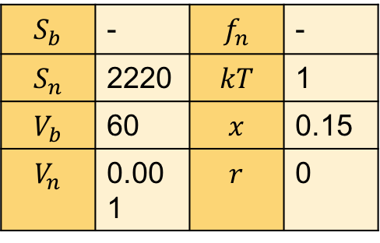
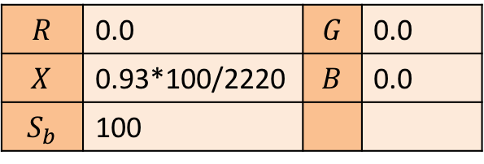
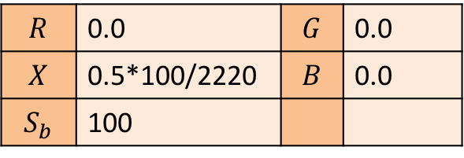
Example 1
Network model – Step 2
Transformer and line parameters
Line 1
$$R$$ | 0.0 | $$G$$ | 0.0
$$X$$ | 0.5*100/2220 | $$B$$ | 0.0
$$S_{b}$$ | 100
Transformer
$$S_{b}$$ | - | $$f_{n}$$ | -
$$S_{n}$$ | 2220 | $$kT$$ | 1
$$V_{b}$$ | 60 | $$x$$ | 0.15
$$V_{n}$$ | 0.001 | $$r$$ | 0
Line 2
$$R$$ | 0.0 | $$G$$ | 0.0
$$X$$ | 0.93*100/2220 | $$B$$ | 0.0
$$S_{b}$$ | 100

Slide 27
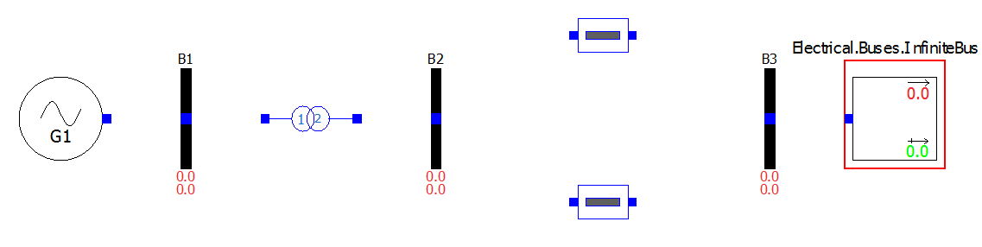
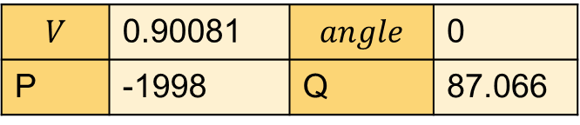
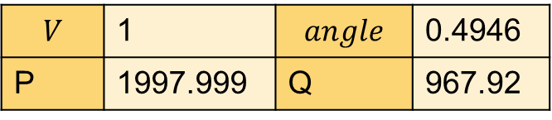
Example 1
Network model – Step 3
Infinite bus is added
Power Flow results are implemented
G1
Infinite bus
$$V$$ | 1 | $$angle$$ | 0.4946
P | 1997.999 | Q | 967.92
$$V$$ | 0.90081 | $$angle$$ | 0
P | -1998 | Q | 87.066

Slide 28
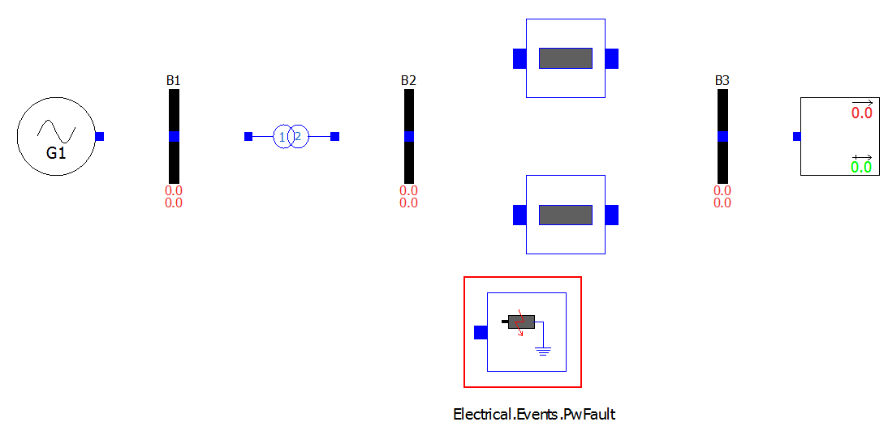
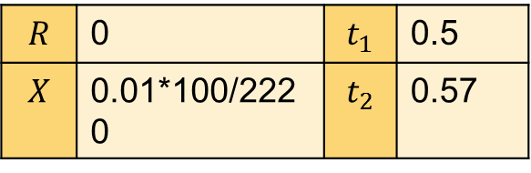
Example 1
Fault
Network model – Step 4
3-phase-to-ground fault is added
$$R$$ | 0 | $$t_{1}$$ | 0.5
$$X$$ | 0.01*100/2220 | $$t_{2}$$ | 0.57

Slide 29
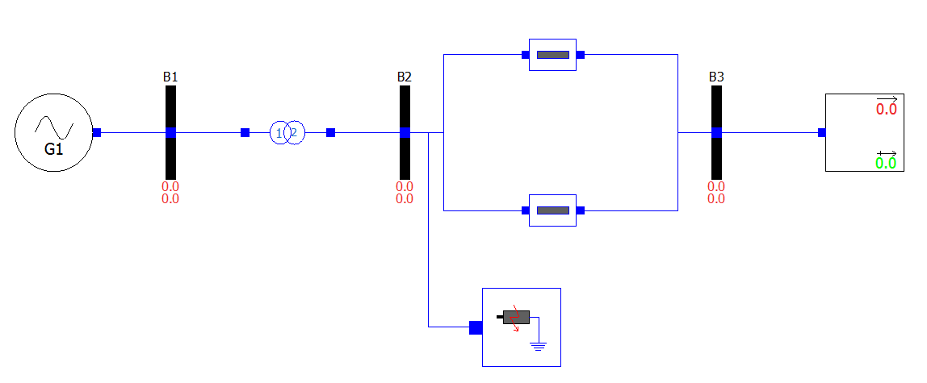
Example 1
Network model – Step 5
The network model is completed by connecting all of the components
Now, the model can be simulated and linearized

Slide 30
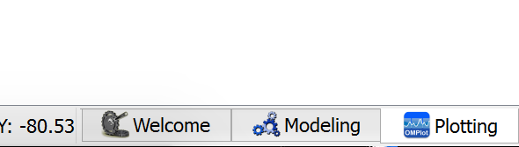
Example 1
Simulation
System will be simulated with 3-phase-to-ground fault at t=0.5s with a duration of 70ms
Simulation results will be compared with the reference results from the PSAT that will be loaded first
PSAT results are provided in a file “PSAT_dyn.csv”
To load the file, the view should be switched to “Plotting” tab

Slide 31
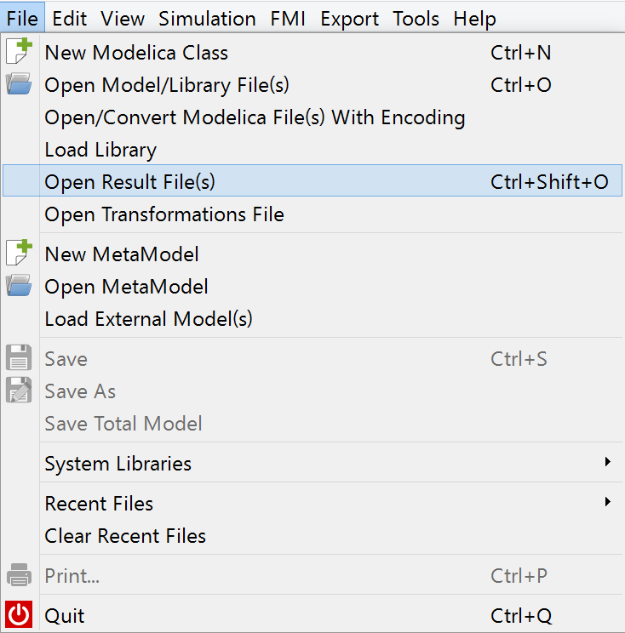
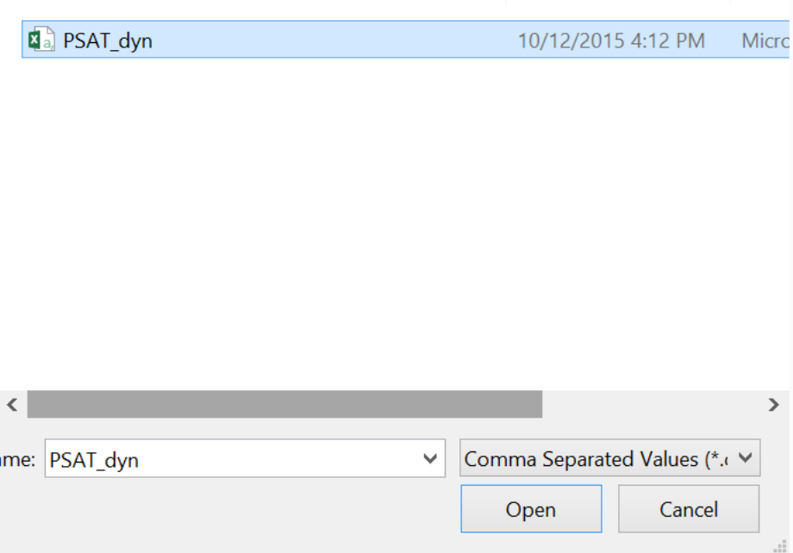
Example 1
Simulation
Result file can be opened by navigating the menu to File->Open Resut File(s)
In the pop-up menu, one has to select “Comma Separated Values” as a file type, navigate to the directory where the file is located and open it

Slide 32
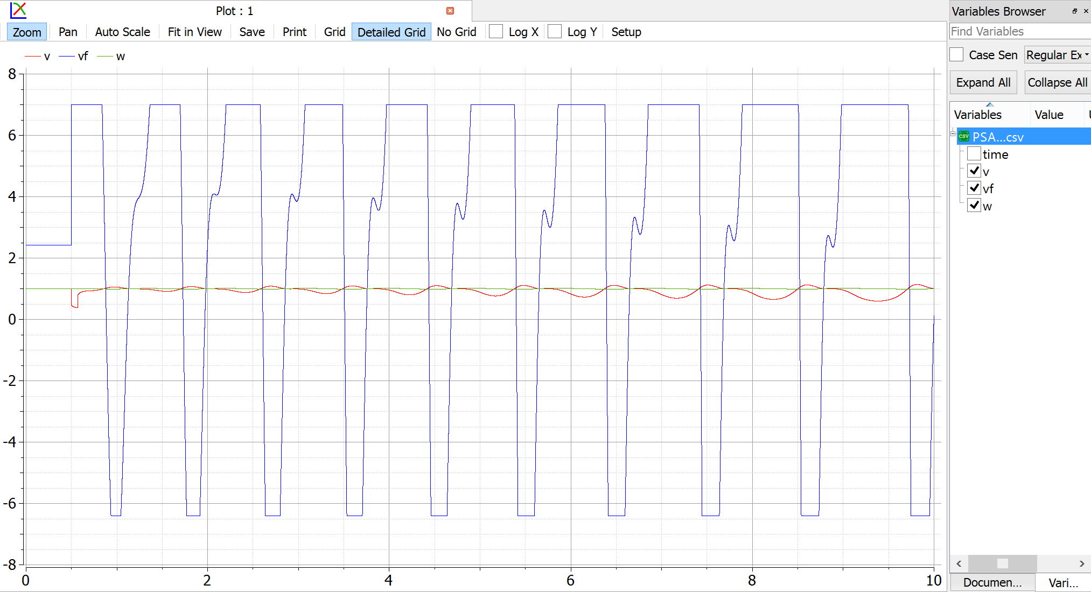
Example 1
Simulation
In the variable browser, three waveforms from the PSAT results are loaded which can be displayed on the plot as it is shown in the figure below
Loaded waveforms are generator terminal voltage, excitation field voltage and the generator speed

Slide 33
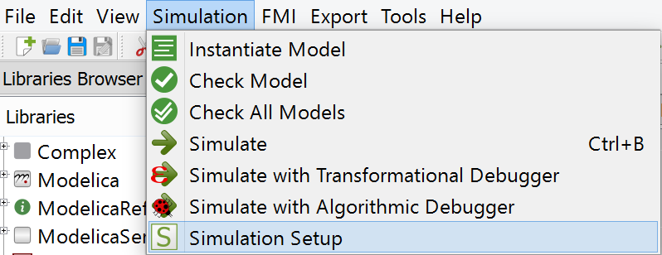
Example 1
Simulation
Before the simulation, solver and its parameters are set to be the same as in the PSAT
Solver is chosen to be Runge-Kutta with a fixed step
More solvers can be chosen in Modelica (depending on the tool), however, to match the model’s response with the one in PSAT choice of the solver is limited

Slide 34
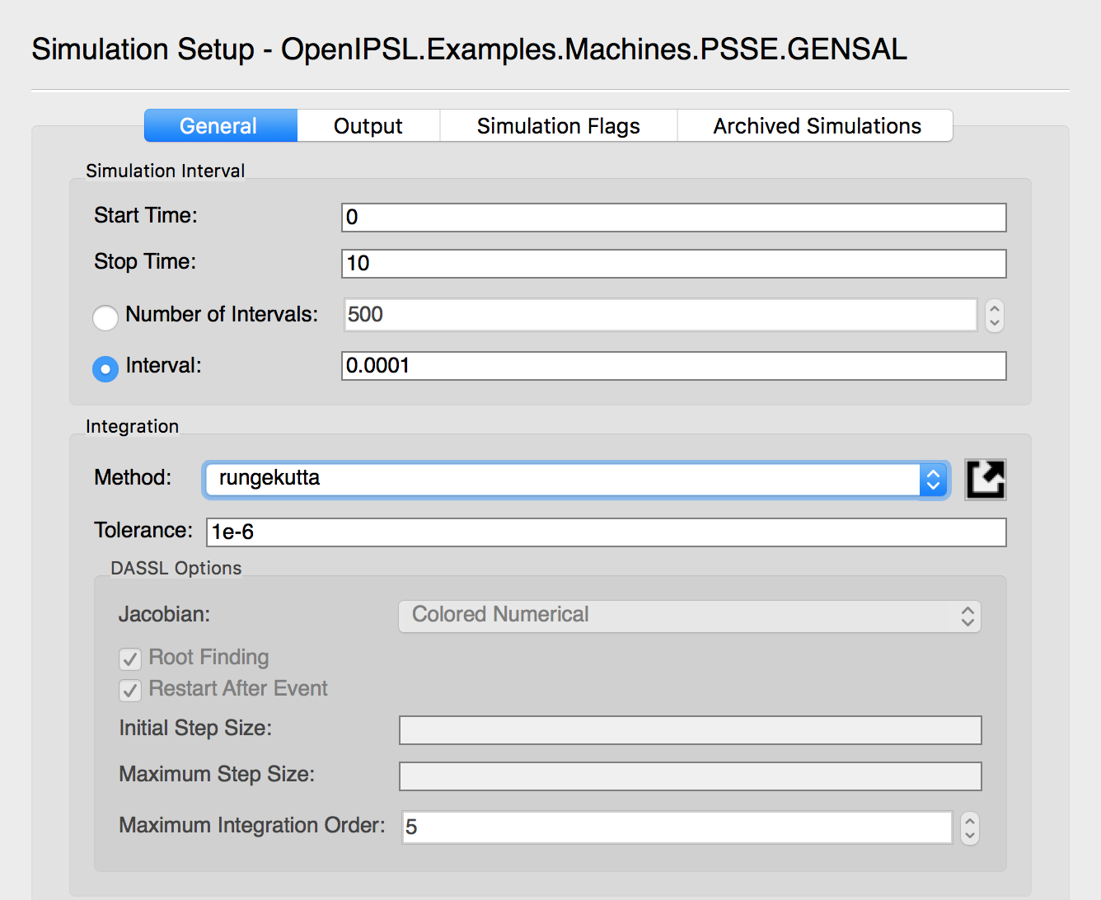
Example 1
Simulation
Simulation time is set to 10s and the tolerance of the solver is set to 1e-6
The time step is set to 0.0001

Slide 35
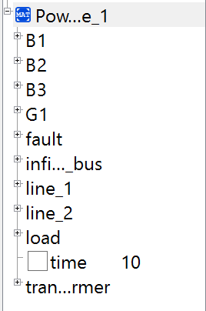
Example 1
Simulation
By pressing the “Simulate” button on the toolbar, simulation of the model is executed
Once the simulation is completed, the Variable Browser is populated with the simulation results

Slide 36
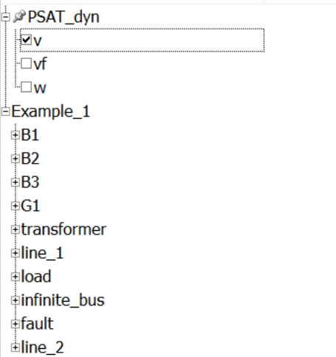
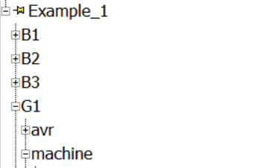
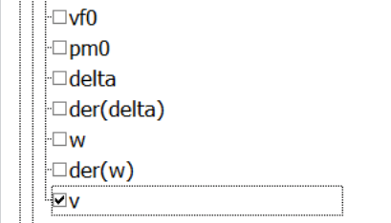
Example 1
Simulation
To display the simulation results or compare it with the results from PSAT, one can mark the check-box next to the variable which will be shown on the plot
To show the terminal voltage of the generator in PSAT and modelica, variables “PSAT_dyn.v” and “Example_1.G1.machine.v” have to be selected

Slide 37



Example 1
Simulation
To display the simulation results or compare it with the results from PSAT, one can mark the check-box next to the variable which will be shown on the plot
To show the terminal voltage of the generator in PSAT and modelica, variables “PSAT_dyn.csv.v” and “G1.machine.v” have to be selected

Slide 38


Example 1
Simulation
To be able to distinguish different signals, let’s adjust the thickness and the pattern of the signal line

Slide 39

Example 1
Simulation
Previous steps produce the plot shown in the figure below showing that the Modelica produces the same simulation results as the PSAT does

Slide 40


Example 1
Linearization
To linearize the system, OpenModelica scripting will be needed
Along with the library, a set of commands was provided (Command_List.txt) to linearize the model and extract the A matrix

Slide 41


Example 1
Linearization
Copy and paste each line from the Command_List.txt for Example 1 to the command prompt in OpenModelica

Slide 42

Example 1
Linearization
The third command will save the A matrix of the linearized state-space model in the variable a as a string

Slide 43

Example 1
Linearization
Copy the output from the previous command without the quotation marks by pressing Ctrl+C

Slide 44

Example 1
Linearization
To save the matrix A as a matrix of Real values type A := and then press Ctrl+V to paste the copied matrix

Slide 45


Example 1
Linearization
It is known that the eigenvalues of the linearized system can be found by solving the following equation:
This can be done by executing the last command (eval,evec) := Modelica.Math.Matrices.eigenValues(A);
$$det\left(A−λI\right)=0$$

Slide 46

Example 1
Linearization
The eigenvalues are now stored in the eval variable and they can be listed by executing eval
Groups of numbers are listed where the first number is real part of the system’s pole and the second one is the imaginary part

Slide 47
Example 1
Linearization
It can be seen that the pair of conjugate poles exists on the right side of the stability plane and thus, the behavior of the system is unstable

Slide 48
Example 2
In the Example 1, it was shown that the system was unstable with a pair of poles on the right side of the stability plane
In the Example 2, Power System Stabilizer (PSS) will be added to the generator in order to stabilize the system

Slide 49

Example 2
The work on Example 2 should continue with the files prepared in a package Tutorial.Working_Examples.Example_2

Slide 50

Example 2
Generator model – Step 1
The first step is to add the model of the PSS Type II and the summation block to the model of the generator

Slide 51

Example 2
Generator model – Step 1
The internal control structure of the PSS can be accessed by right-clicking on the PSS block and selecting “View Class”

Slide 52

Example 2
Generator – Step 1
PSS should be parameterized as shown in the table
PSS
$$v_{s,max}$$ | 0.2 | $$T_{1}$$ | 0.154
$$v_{s,min}$$ | -0.2 | $$T_{2}$$ | 0.033
$$K_{w}$$ | 1.41 | $$T_{3}$$ | 1
$$T_{w}$$ | 0.001 | $$T_{4}$$ | 1

Slide 53

Example 2
Generator – Step 2
When the signals of the generator model are connected as shown, model of the generator is completed

Slide 54

Example 2
Simulation
Simulation steps can be repeated as it was shown in the Example 1
This time, reference simulation results from the PSAT can be found in the file “PSAT_dyn_PSS.csv”
After the simulation is executed, variable browser should look as it is shown below

Slide 55

Example 2
Simulation
Simulation results can be plotted again
Comparison of the PSAT and Modelica simulation results of the PSS signal is shown on the figure below

Slide 56
Example 2
Linearization
To linearize the system, OpenModelica scripting will be needed
Along with the library, a set of commands was provided (Command_List.txt) to linearize the model and extract the A matrix

Slide 57

Example 1
Linearization
Copy and paste each line from the Command_List.txt for Example 1 to the command prompt in OpenModelica

Slide 58

Example 2
Linearization
The rest of the steps shall be repeated as it was shown in Example 1
The same procedure with a linearized system from Example 2 results in the new set of eigenvalues

Slide 59
Example 2
Linearization
The conjugate pair of poles that was on the right side of the plane in Example 1 was, by introducing the PSS, moved to the left side of the stability plane and, thus, the system is now stable

Slide 60

Example 3

Slide 61
Example 3
Example 3 contains the model of the IEEE 9 Bus system
It is pre-configured with all of the power flow and dynamic data
In the previous two examples, you learned how to build the models of the power system, introduce the faults, run the dynamic simulations and perform the linearization of the model
In Example 3 you are free to explore the model and introduce various faults

Slide 62

Example 3
You can, for instance, introduce the bus fault …

Slide 63
Example 3
... or open the line at the given time instant*
*Model of the line with opening is OpenIPSL.Electrical.Branches.PwLine2Openings

Slide 64

Example 3
Step disturbance to the voltage reference of the generators can be introduced by setting the desired refdisturb_x parameter to true

Slide 65
Bonus: KRK 2-Area model
Once the OpenIPSL is loaded (see previous slide) in OMEdit, you can load the Tutorial package:
Browse Windows Explorer to the location of the unzipped folder
Drag & drop the TwoAreas.mo file to the Library Browser in OMEdit.

Slide 66



Demo of Modelica and Other Tools
Modelica and Python
Python opens countless new applications for OpenIPSL.
In this demo, the integration of Modelica and Python will be leveraged to perform a root locus.

Slide 67



Demo of Modelica and Other Tools
Modelica and FMI (Functional Mockup Interface)
FMI is a standard for model exchange between different tools. Modelica is FMI compliant. Python opens countless new applications for OpenIPSL.
In this demo, FMI and the FMI toolbox will be leveraged to simulate an OpenIPSL model in Matlab

Slide 68












Questions?
Thanks to all current and former OpenIPSL Developers @ KTH
Luigi Vanfretti
Achour Amazouz
Mohammed Ahsan Adib Murad
Francisco José Gómez
Giusseppe Laera
Tin Rabuzin
Jan Lavenius
Le Qi
Maxime Baudette
Mengjia Zhang
Tetiana Bogodorova
Joan Russiñol Mussons
End

Slide 69
OpenIPSL Tutorial A Modelica Library for Power Systems Simulation
Assoc. Prof. Luigi Vanfretti
luigiv@kth.se,
https://www.kth.se/profile/luigiv/
Preparatory
Homework!
Notes:
Airport to central station
Take line 3 or line 4 to Nyl… (Stattnet)

Slide 70
Requirements
Requirements for the workshop are:
We have only tested our tutorial for the following configurations.
Windows:
PC with installed Windows 7 or later
Installation of OpenModelica
Mac:
OSX El Capitan
Installation of OpenModelica (binaries!)
Xcode (Version 8.0)

Slide 71
Getting Started with OpenModelica and OpenIPSL
This presentation is a 2-part tutorial containing the preparatory work for the tutorial to be presented at the PTI event.
Part 1: Setting up
Part 2: Using OpenIPSL

Slide 72
Part 1

Slide 73
Installation of
Instructions:
Download the installation package
Windows : https://build.openmodelica.org/omc/builds/windows/releases/1.9.6/OpenModelica-v1.9.6.exe
Mac: https://build.openmodelica.org/omc/builds/mac/binaries/latest-release-1.9.6.mpkg
Launch the Installation package and follow the instructions with default options
Note! Compatibilty with OpenIPSL is checked for OpenModelica version 1.9.6.

Slide 74
Check of OpenModelica
Tasks to check OpenModelica is correctly installed on your computer:
Start OpenModelica Connection Editor (OMEdit)
In the Libraries Browser navigate to Modelica.Blocks.Examples.PIDController
Select Runge Kutta as a solver and simulate the model
In the “Plotting” view, plot variable speedSensor.w

Slide 75

Check of OpenModelica – Step 1
Upon launch, the Connection Editor will present the following window

Slide 76

Check of OpenModelica – Step 2
Browse the Modelica library to find the PID_Controller and open it
Double-click to open

Slide 77

Check of OpenModelica – Step 3
Simulation settings are accessed on the toolbar:
Adjust the settings to match the followings :
Click on Simulate to launch the simulation

Slide 78


Check of OpenModelica – Step 4a
Once the simulation is completed (100 %):
Access the plotting facility by clicking on the Plotting tab in the lower right corner of the screen

Slide 79

Check of OpenModelica – Step 4b
In the plotting facility, browse the variable to find the rotational speed w

Slide 80

Check of OpenModelica – Final Result
If your screen looks like this, you’re ready to go!

Slide 81
Part 2

Slide 82

Download OpenIPSL!
Go to our Github repo:
https://github.com/SmarTS-Lab/OpenIPSL/releases/tag/Tuto_PTI_Brazil_17
Note: A dedicated package will be prepared for the tutorial and uploaded soon. We will request you to download that package on the day of the tutorial so everybody has the same files. The dedicated package will also be available on a usb stick that we can circulate on the day of the tutorial.
Click Here!

Slide 83

Load the OpenIPSL to OMEdit
External libraries, e.g. OpenIPSL, must be loaded in OMEdit to be used:
Unzip the package downloaded at the previous step
Open OpenModelica Connection Editor (OMEdit)
Browse Windows Explorer to the location of the unzipped folder
Open the /OpenIPSL folder
Drag & drop the package.mo file to the Library Browser in OMEdit.

Slide 84

Load an Application Example to OMEdit
Once the OpenIPSL is loaded (see previous slide) in OMEdit, you can load an Example:
Browse Windows Explorer to the location of the unzipped folder
Open the /Application Examples/KundurSMIB folder
Drag & drop the package.mo file to the Library Browser in OMEdit.

Slide 85


Check that it simulates
Click on “SMIB”, “Simulation Setup” and “Simulate”
Click Here!
Click Here!

Slide 86

Plot the results
Click on “Plotting”, scroll to “B1” and select “V”

Slide 87

Finally, take a look a our documentation!
Go to: http://openipsl.readthedocs.io/en/latest/index.html

Slide 88
You are ready! See you for the workshop

